Slide 1
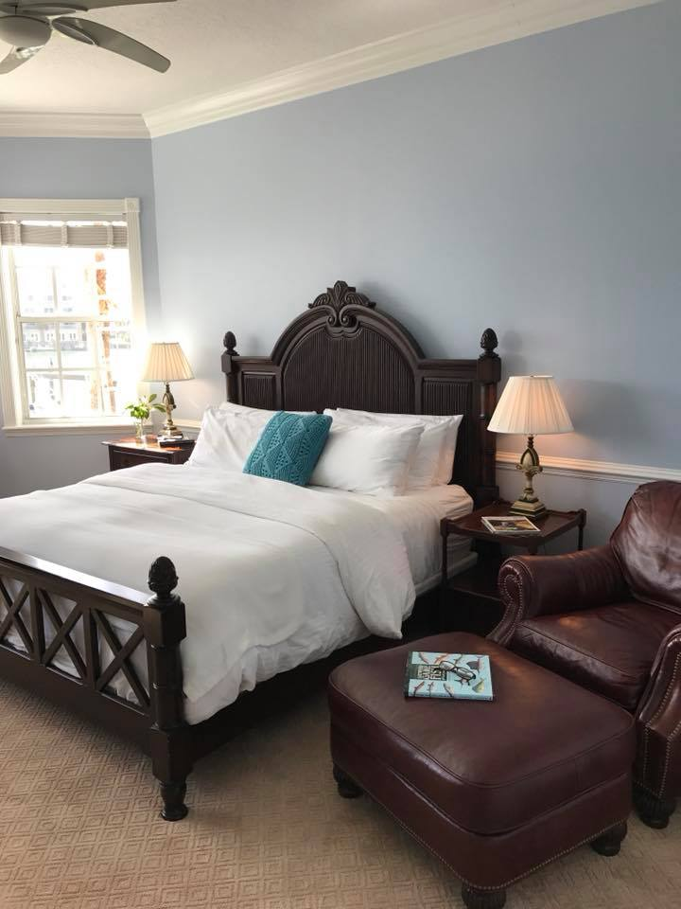
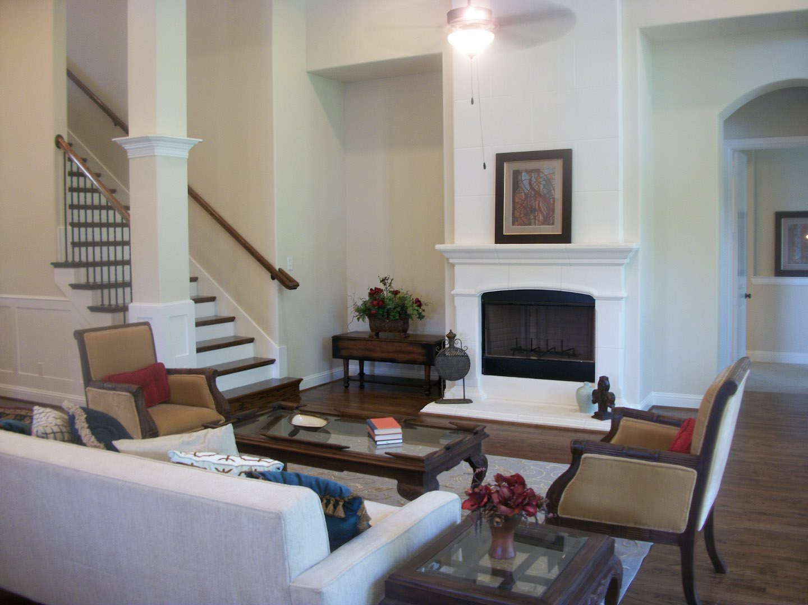
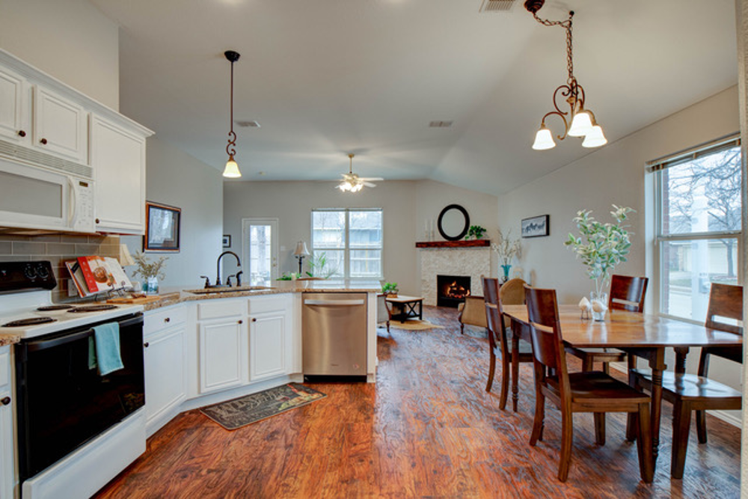
Staging Places
by Bev
Beverly Bain
817-475-3541
Bev@stagingplacesbb.com
You can never make a second, first impression!
Staging turns a home into a property for sale.
I carefully remove your personal affects and showcase the best assets of your home to impress buyers.
2019 Study results from National Association of Realtors
Seller Agent
Buyer Agent
22% of sellers' agents reported an increase of 1-5% of the selling amount when a property is staged, and 17% reported an increase of
6-10%.
40% of buyers’ agents reported that staging had an effect on most buyer's view of the home.
83% of buyers’ agents reported that staging made it easier for a buyer to visualize the property as a future home.

